Slide 1
Python List

Slide 2
Python Lists
The list is a most versatile datatype available in Python which can be written as a list of comma-separated values (items) between square brackets.
It can have any number of items
Items in a list need not be of the same type.
list1 = [‘Delhi', A', 1997, 2000];
my_list = [1, "Hello", 3.4]

Slide 3
Access elements from a list?
There are various ways in which we can access the elements of a list.
List Index
We can use the index operator [] to access an item in a list.
In Python, indices start at 0. So, a list having 5 elements will have an index from 0 to 4.
Trying to access indexes other than these will raise an IndexError.

Slide 4
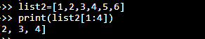
my_list = [‘a', ‘e', ‘r', ‘o', ‘p‘, , ‘l‘, , ‘a‘, , ‘n‘, ‘e‘, ]
print(my_list[0]) OUTPUT a
list2 = [1, 2, 3, 4, 5, 6, 7 ];
print (list2[1:4])

Slide 5
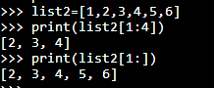
Negative indexing
Python allows negative indexing for its sequences.
The index of -1 refers to the last item, -2 to the second last item and so on.
my_list = ['p','r','o','b','e']
print(my_list[-1]) Output e

Slide 6
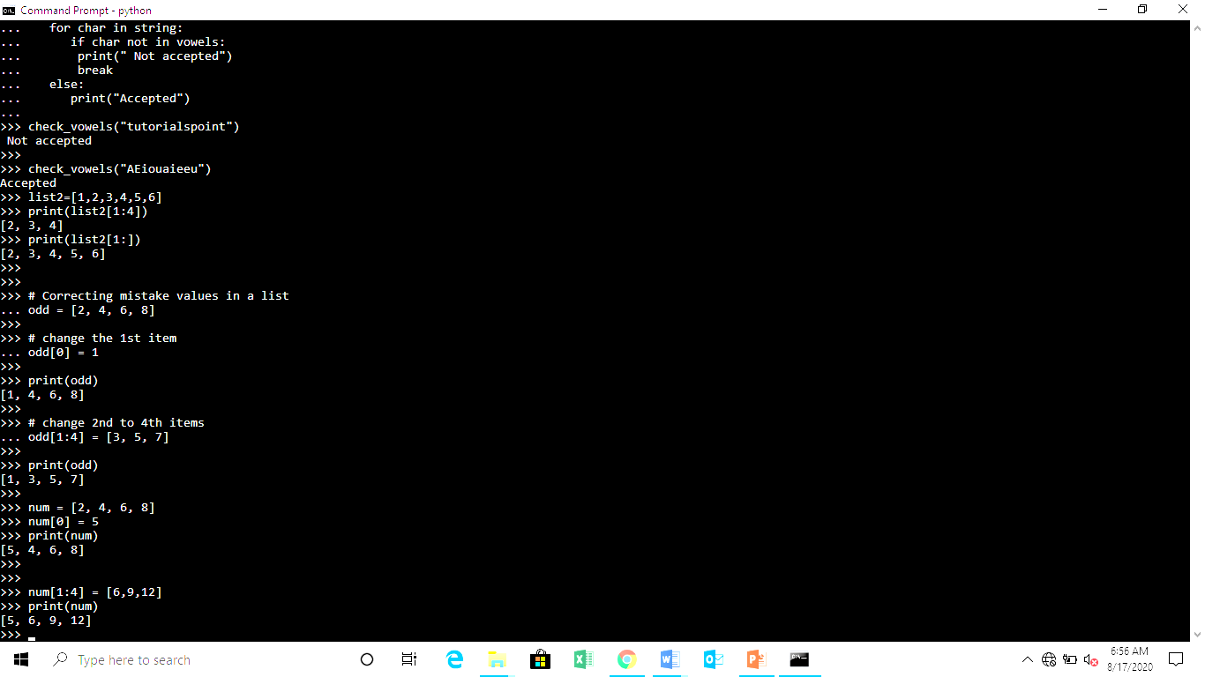
change or add elements to a list
Lists are mutable, meaning their elements can be changed
use the assignment operator (=) to change an item or a range of items.
num = [2, 4, 6, 8]
num[0] = 5
print(num)
num[1:4] = [6,9,12]
print(num)

Slide 7
list with multiple distinct or duplicate elements
A list may contain duplicate values with their distinct positions and hence, multiple distinct or duplicate values can be passed as a sequence at the time of list creation.
List1 = [1, 2, 4, 4, 3, 3, 3, 6, 5]
print(len(List1))

Slide 8
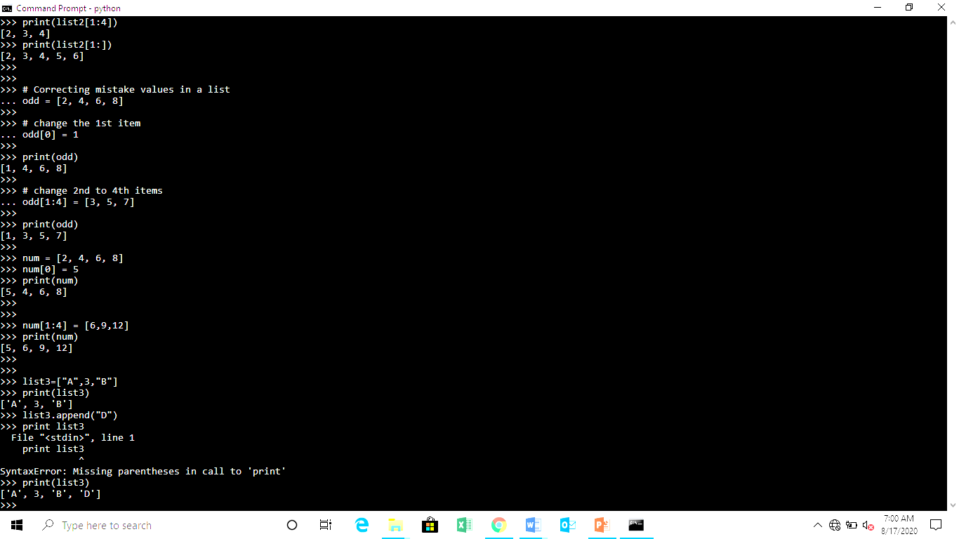
Elements can be added to the List by using built-in append() function.
Only one element at a time can be added to the list by using append() method, for addition of multiple elements with the append() method, loops are used.
for i in range(1, 4):
List.append(i)
print("\nList after Addition of elements from 1-3: ")
print(List)

Slide 9
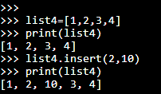
insert() method
append() method only works for addition of elements at the end of the List, for addition of element at the desired position, insert() method is used.
Unlike append() which takes only one argument, insert() method requires two arguments(position, value).

Slide 10
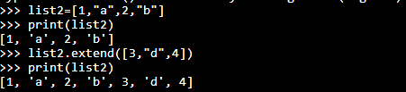
extend() method
Other than append() and insert() methods, there’s one more method for Addition of elements, extend(), this method is used to add multiple elements at the same time at the end of the list.

Slide 11
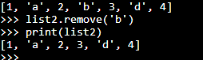
remove() method
Elements can be removed from the List by using built-in remove() function but an Error arises if element doesn’t exist in the set.
Remove() method only removes one element at a time, to remove range of elements, iterator is used.
The remove() method removes the specified item.

Slide 12
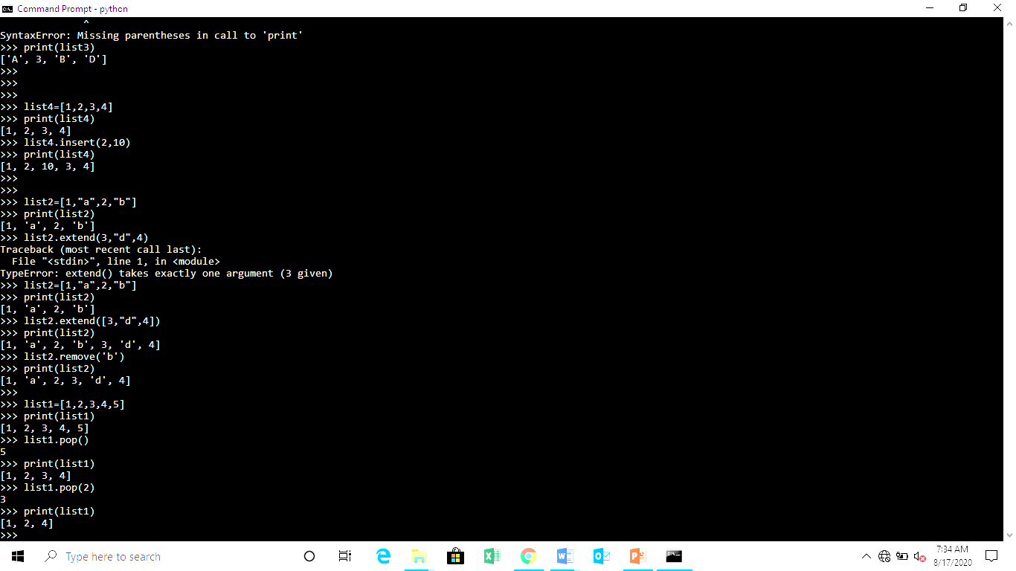
pop() method
Pop() function can also be used to remove and return an element from the set, but by default it removes only the last element of the set.
To remove element from a specific position of the List, index of the element is passed as an argument to the pop() method.

Slide 13
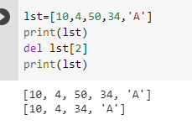
Del method
In Python we can use the del statement to remove one or more items from a list.

Slide 14
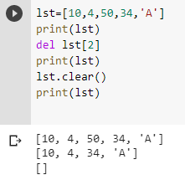
Clear method
The clear() method removes all items from the list.

Slide 15
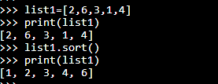
Sort Method

Slide 16
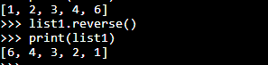
Reverse Method

Slide 17
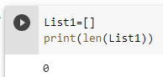
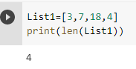
Getting the size of Python list
Python len() is used to get the length of the list.
List1 = []
print(len(List1))
List2 = [10, 20, 14]
print(len(List2))

Slide 18
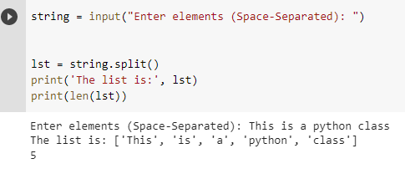
List Input as String (Split Function)

Slide 19
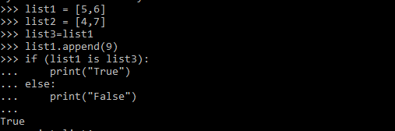

Slide 20
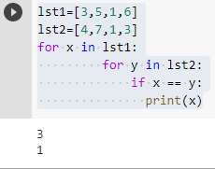
1. Write a program to print common elements from 2 lists.

Slide 21
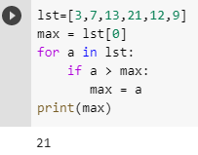
2. Write a program to find the largest number in the list

Slide 22
3. Write a Python program to get the smallest number from a list.

Slide 23
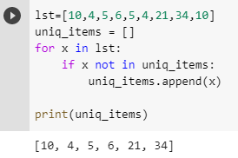
4. Write a program to delete the duplicate elements from a list

Slide 24
5. Find the second largest number in a list
6. Write a program to convert every element of a list into its square.
7. Write a program to count the no. of occurrences of an element in a list.
8. Write a program to print negative Numbers in a List

Slide 25
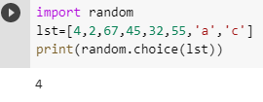
9. Write a Python program to select an item randomly from a list.
10. Write a Python program to find common items in two lists.

Slide 26
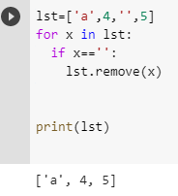
11. Write a program to remove an empty element from a list.

